Slide 1
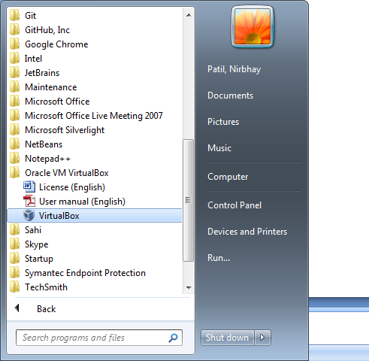
Starting VM machine
Step 1
Click on Virtualbox.exe installed in your machine.
Menu could be found in Start menu or taskbar.
Screen 1

Slide 2
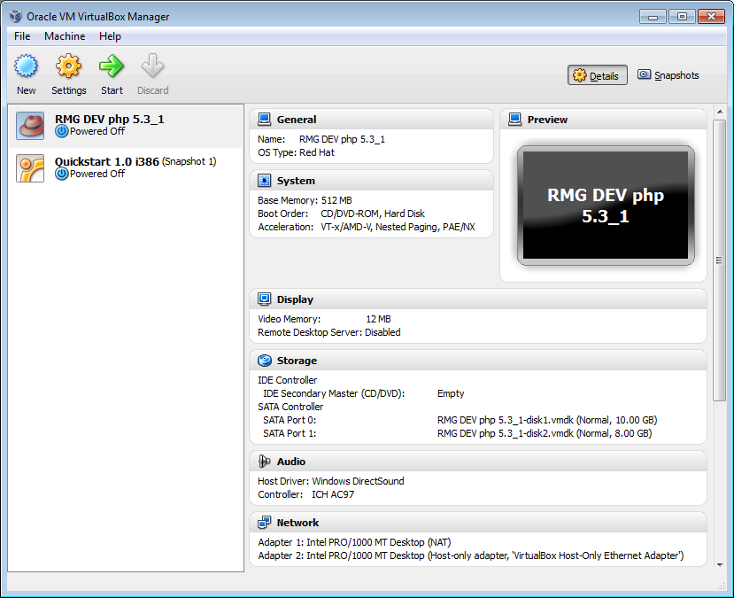
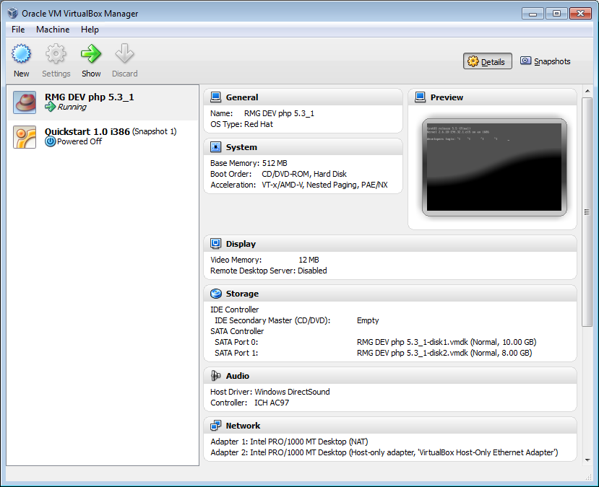
Starting VM machine
Step 2
After starting Oracle VM manager
Inside Oracle VM manager select
RMG DEV php 5.3_1 option and click on green Start
arrow as shown in screen 2
Screen 2
Step 3
Status of VM should be Running as shown in Fig 3.
And another window should opened asking user to enter developer login and password.
User should not use this window, but another putty terminal should be used.
In next steps, will inform how to open and run Behat test from putty terminal .
Screen 3

Slide 3
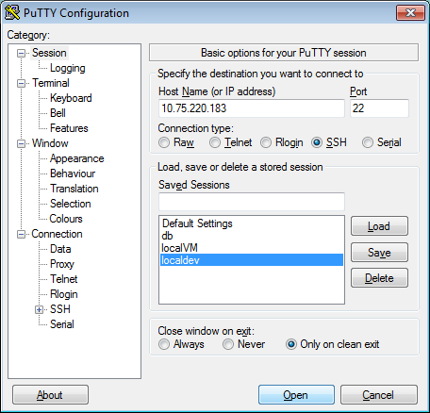
Starting putty which connects VM.
Step 4
Click on putty.exe in taskbar/start menu, wherever it is located in your machine.
There should be localdev profile present as shown left screen.
Double click on localdev OR double click on Open button as shown in screen 4.
Screen 4

Slide 4
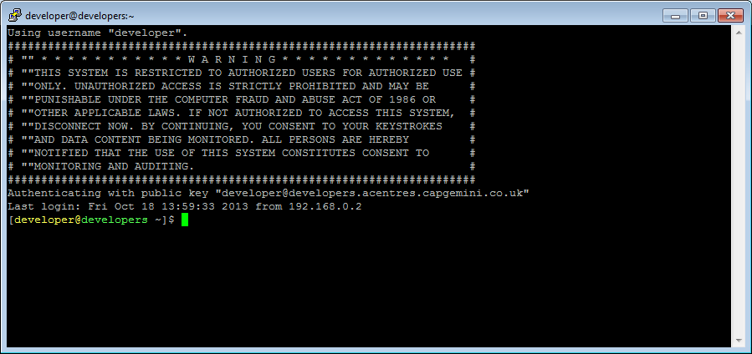
Starting putty which connects VM.
Step 5
After step 4 you should be able to view screen 5 as below.
To move to folder where all behat test for RML, PFW, POL brands are saved and developed so far
type below command.
cd build/tools/behat
User should be taken to tools/build/behat folder.
wd_host: 'http://10.75.220.161:4444/wd/hub'
Screen 5

Slide 5
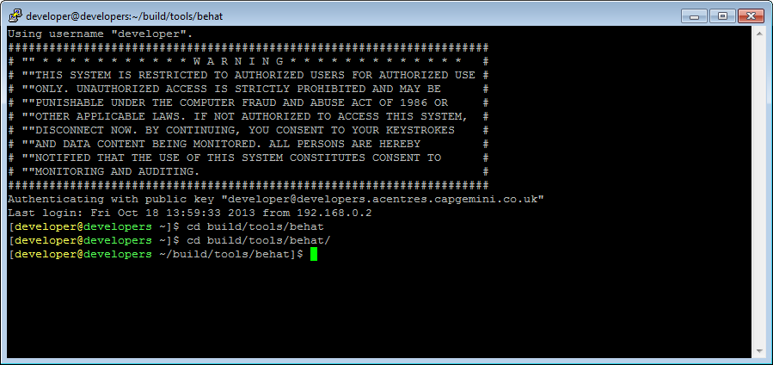
Starting putty which connects VM.
Step 6
After step 5 user should be able to see below screen.
From this path we should be able to execute Behat test scripts.
Screen 6

Slide 6
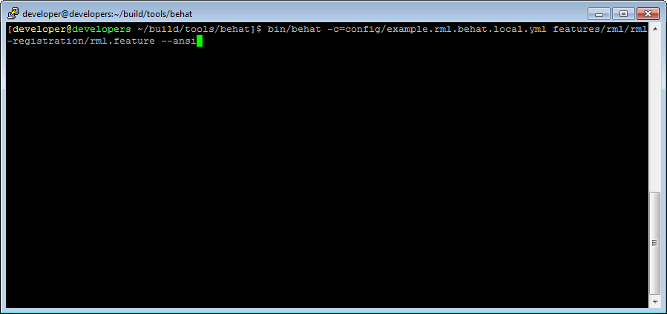
Starting putty which connects VM.
Step 7
After step 5 user should be able to see below screen.
From this path we should be able to execute Behat test scripts.
bin/behat -c=config/example.rml.behat.local.yml features/rml/rml-registration/rml.feature --ansi
Next slide will explain what this command exactly require to execute.
Screen 7

Slide 7
Starting putty which connects VM.
Step 8
bin/behat -c=config/example.rml.behat.local.yml features/rml/rml-registration/rml.feature –ansi
This is shell executable file reference to Behat framework.(In short )
This command line option acts as input to Behat framework in .YAML file, explained in later section.
This parameter takes complete/absolute file path of Behat automated test to be executed ( aka Behat feature/scenario).
What is bin/behat?
This is executable file in similar way .exe is used in invoking another automation tool.
What is .yml file ? Why it is required?
This file contains information of configuration parameters defined under a profile name root default:
Behat framework tries to load .yml file mentioned in option –c OR –config.
Parameters like browser name: firefox tells Behat which browser need to be used for execution.
wd_host :'http://10.75.220.161:4444/wd/hub‘ change ip of your local machine here.
What is .feature file ?
This file contains actual automated test scenario.
One should know exact absolute path of test before execution.

